Slide 1
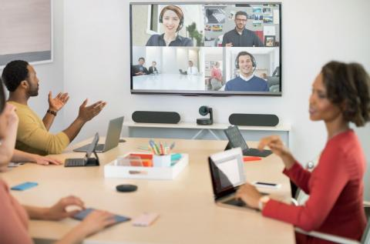


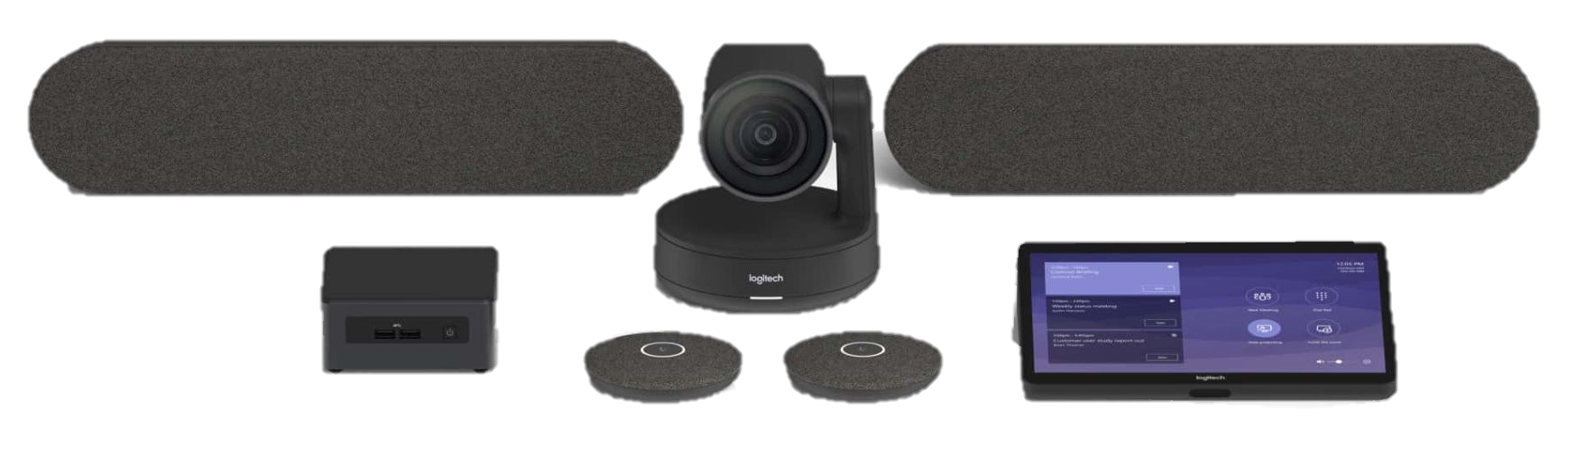

Standard Teams Room

Slide 2



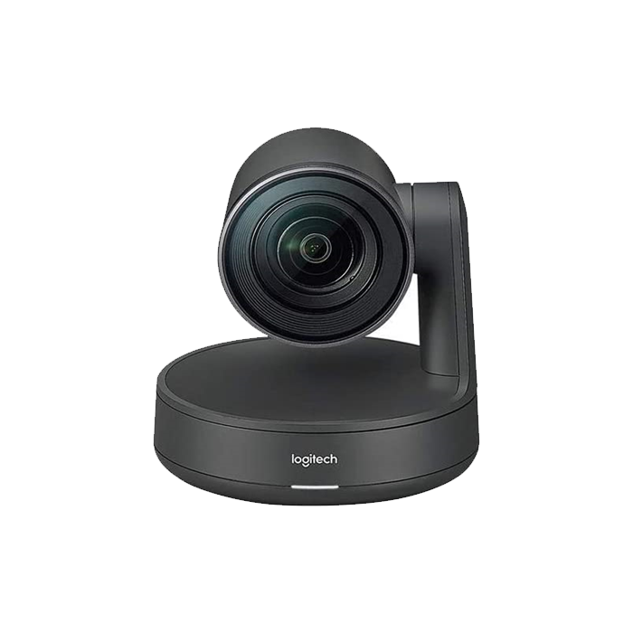

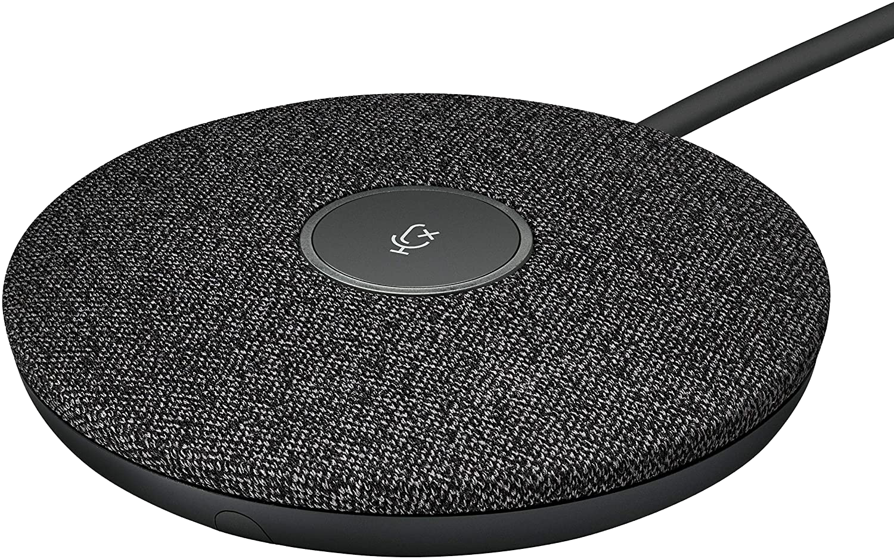
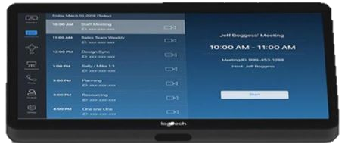
Standard Teams Room
Content
VDO
75”
75”

Slide 3
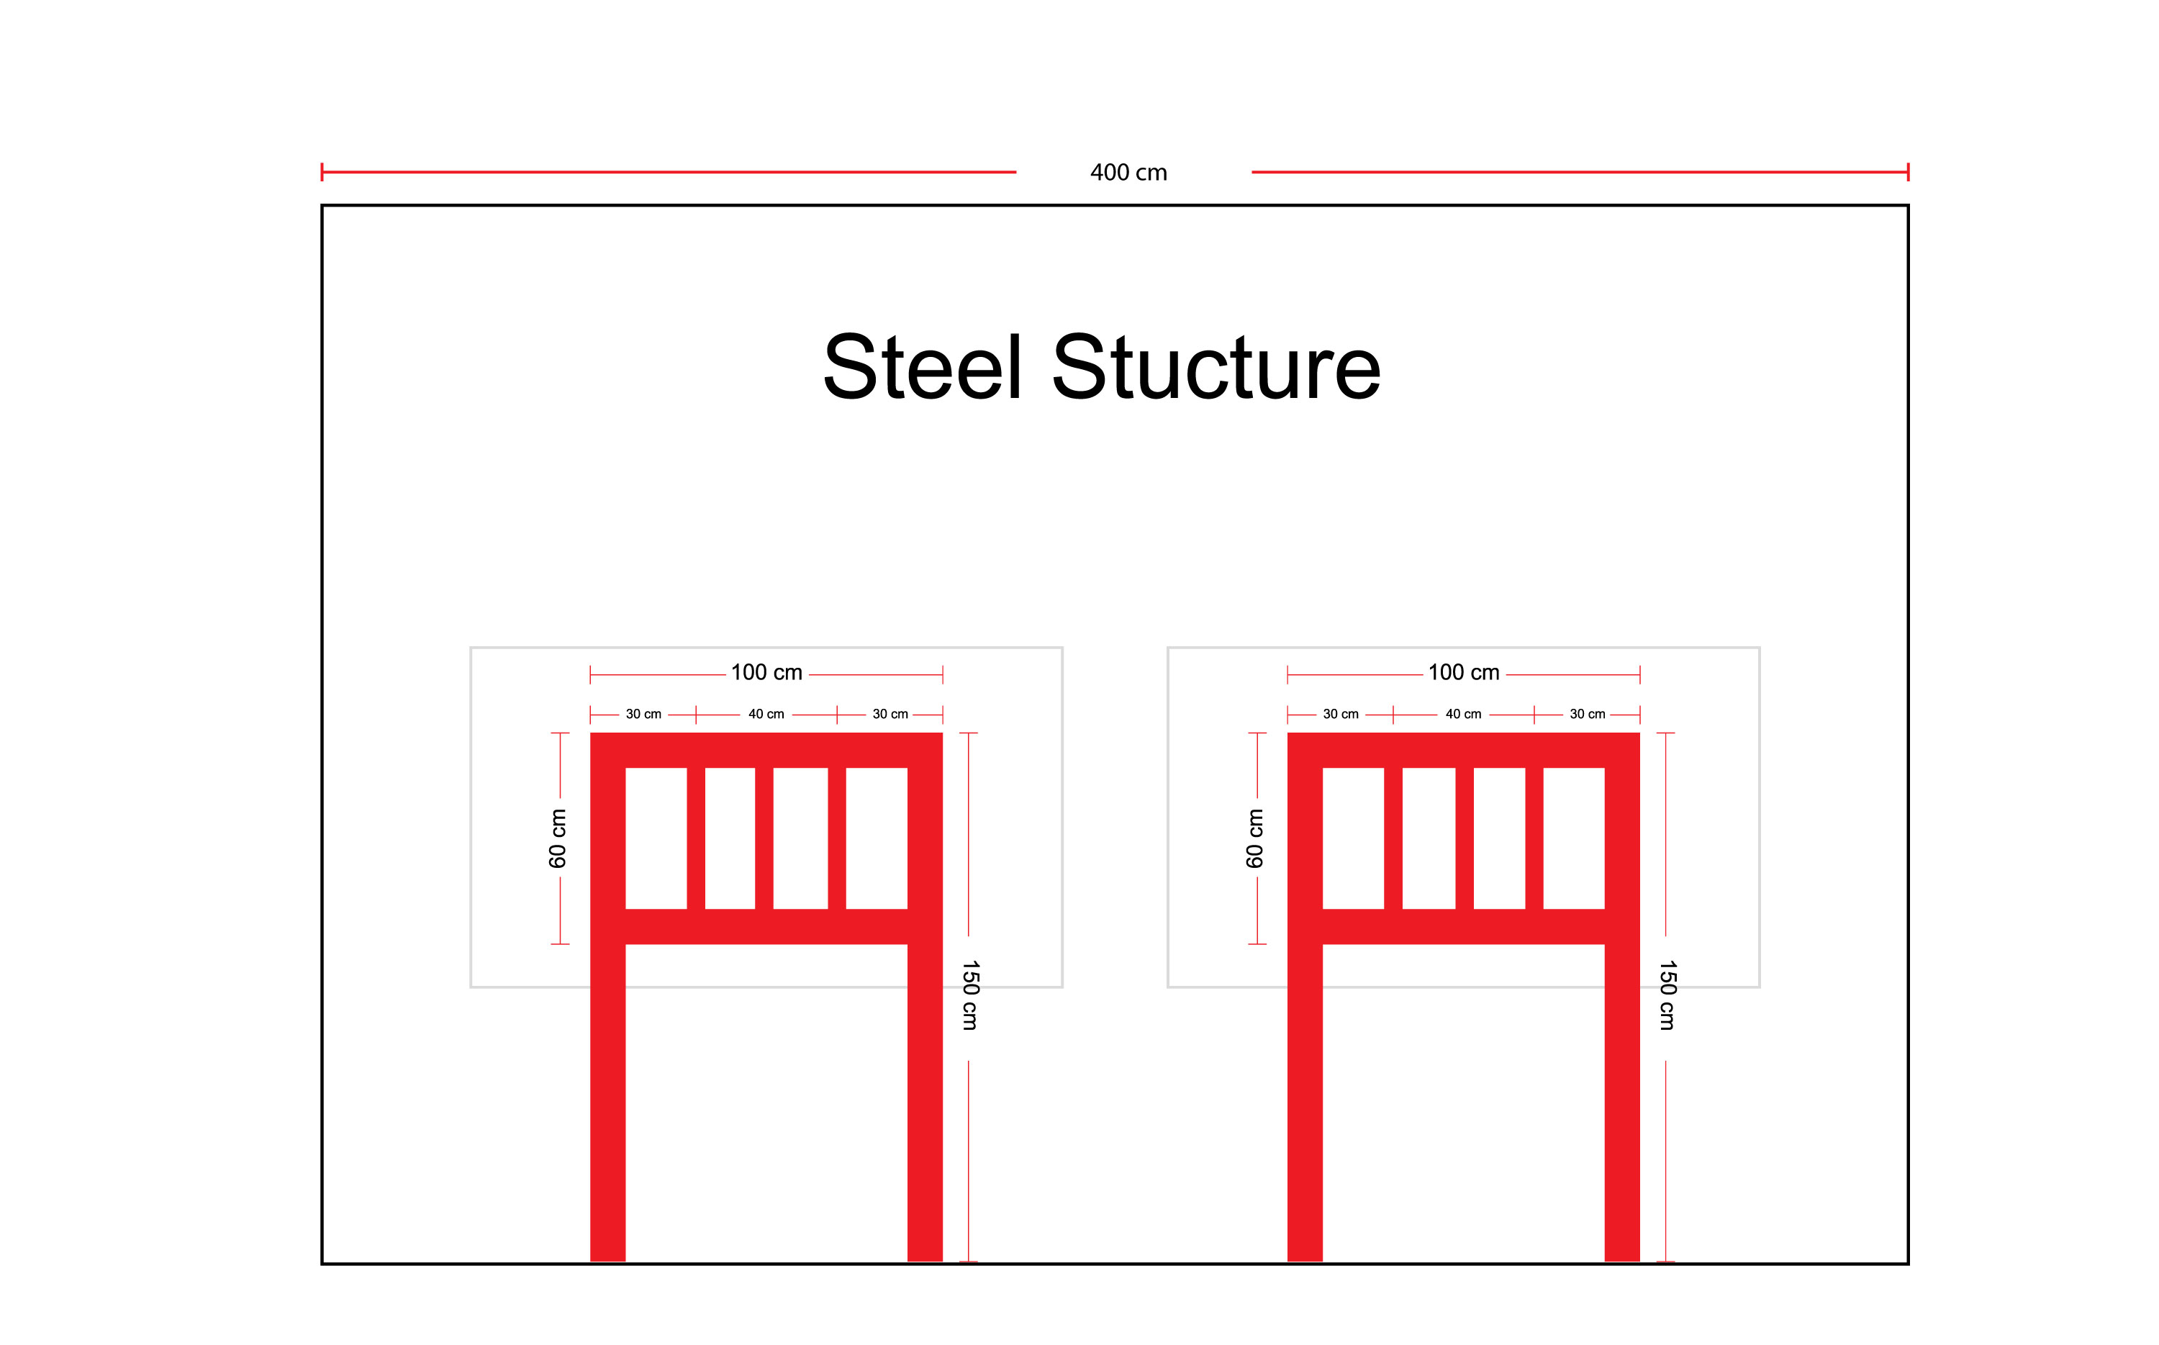
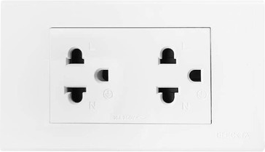
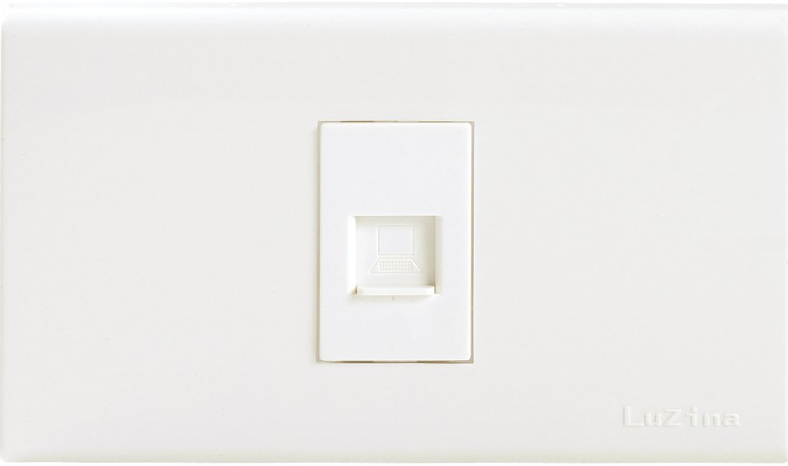
Steel Structure Require
ปลั๊กไฟ
จุด LAN

Slide 4
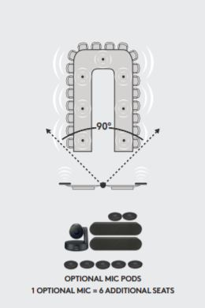
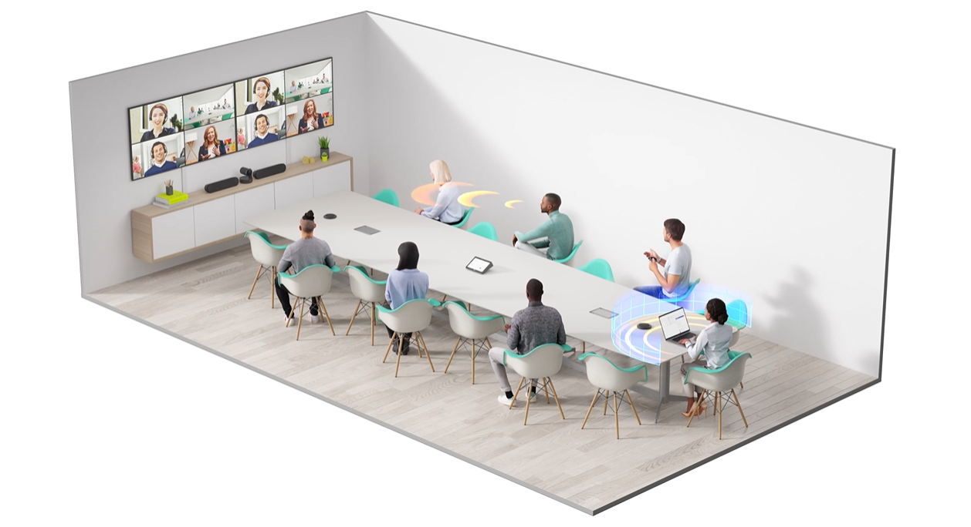
Scene Graph in a Conference Room
Scene Graph in a Conference Room

Slide 5

Logitech Rally Plus
Ultra-HD 4K
Camera
15X HD Zoom
Auto Focus
Just Plug-and-Play
90° field of view
Datasheet : rally-datasheet.pdf (logitech.com)

Slide 6
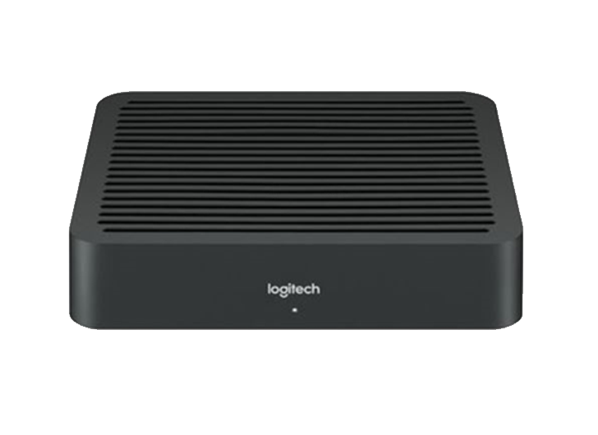
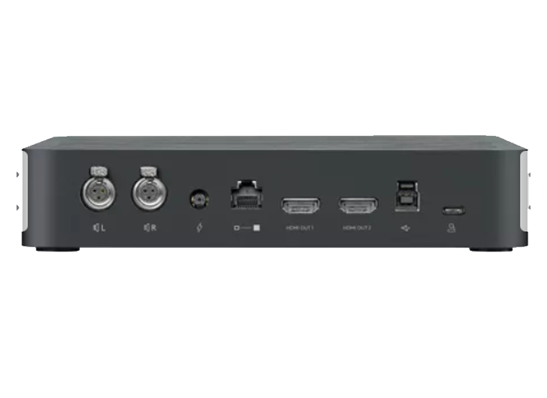
Logitech Rally Plus
Logitech Rally Table Hub
The Logitech Rally Table Hub is the connection point for the microphones and the meeting room computer at the table.
Logitech Rally Display Hub
The Logitech Rally Display Hub is the Connection point for the speakers, HDMI to the displays
Datasheet : rally-datasheet.pdf (logitech.com)

Slide 7
Logitech Rally Plus
Logitech Rally Speaker
The Logitech Rally Speaker is designed to support up to 2 Rally Speakers for larger rooms with clear audio. Equipped with RightSound™ technologies that virtually eliminate distortion, clipping and vibration, the Rally Speaker ensures voices are clearly heard whilst maintaining comfortable volume levels throughout the room.
Logitech MIC POD
The Logitech MIC POD is RightSound Technology and
multiple beamforming elements in every individual mic pod, the audio focus is always automatically on the active speaker. • Range: 15 ft / 4.5m diameter
• Four microphones with eight beamforming elements
• Mute button with LED status indicator
Datasheet : rally-datasheet.pdf (logitech.com)

Slide 8
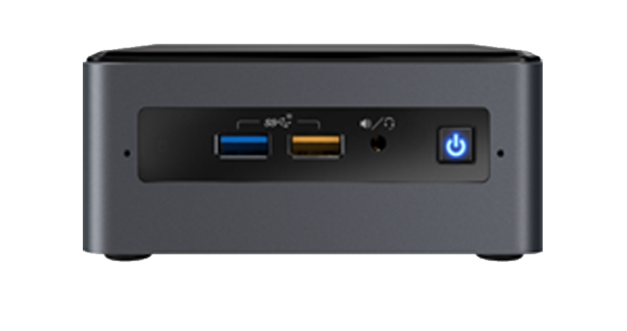
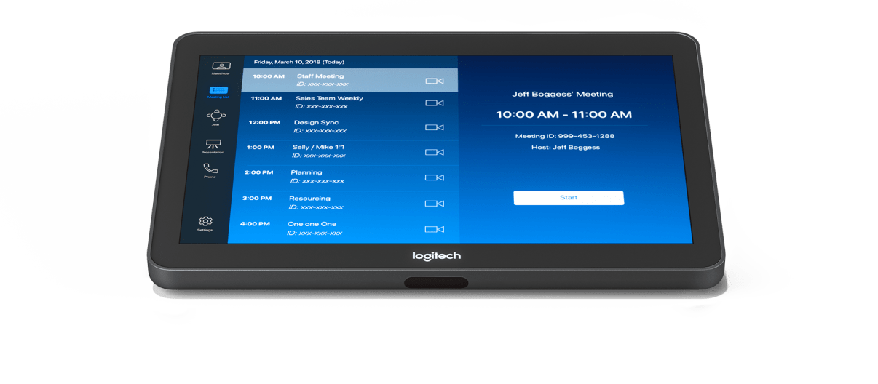
Logitech Tab & NUC
Logitech NUC Mini PC
• Intel® Core™ i5
• Memory 16GB (2x8GB)
• Storage 250 GB SSD
• 1 x HDMI 2.0 video output
• Bluetooth 5 and Wi-Fi 6
• 3 x USB 3.1 Type-A
• 1 x 10/100/1000M Ethernet port
Datasheet : Intel NUC
Logitech TAP
MEETING ROOM TOUCH CONTROLLER FOR VIDEO CONFERENCING ROOM SOLUTIONS
• One-touch join
• 10.1” touch display
• HDMI input for content sharing
• Built-in motion sensor saves power when idle
Datasheet : tap.pdf (logitech.com)

Slide 9
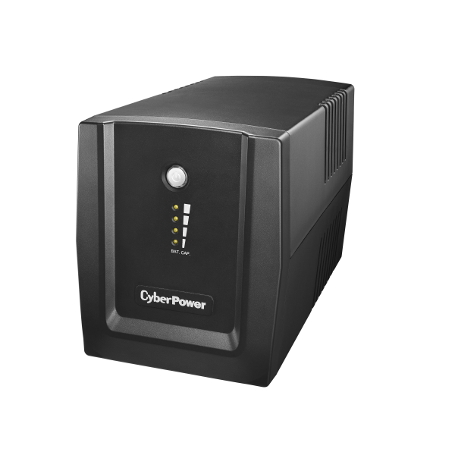
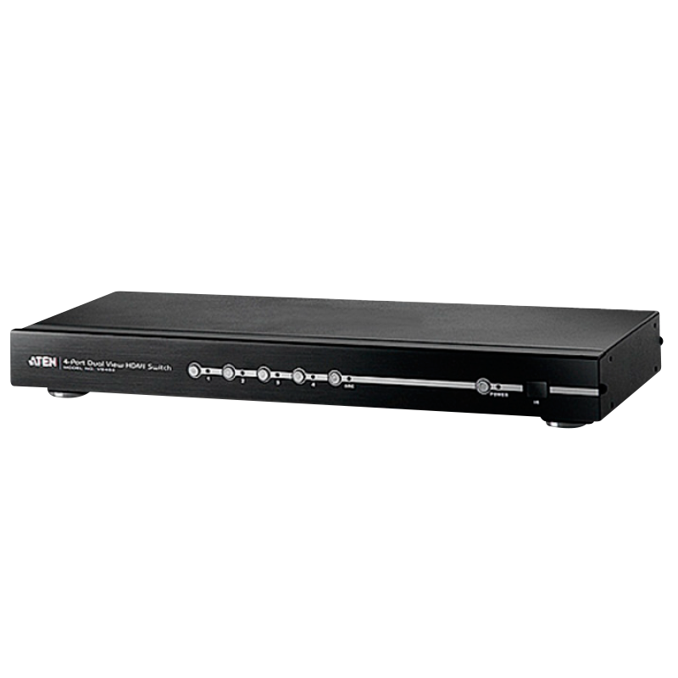
UPS & HDMI Splitter
CYBER POWER UT1500E
VA 1500 Runtime at 90W (min) 60
Watts 900 Output Voltage 230V
VS482 4 IN 2 OUT
The VS482 supports up to four HDMI image signal sources and two HDMI output devices (displays) and was specially developed for modern applications in HDTV and A/V receivers. The VS482 supports the HDMI standards and is even suitable for 3D content and the ARC function (Audio Return Channel)
Datasheet : VS482.pdf

Slide 10
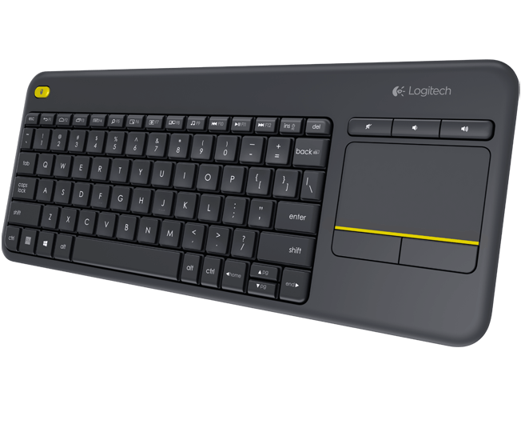
Wireless Touch Keyboard
Logitech K400 Plus Wireless
Connection Type : Logitech Unifying protocol (2.4GHz)
Special Keys : Mute, Volume Down, Volume Up
Connect / Power : On/Off Switch
Battery Details : 2 x AA
Datasheet : Logitech K400.pdf (logitech.com)

Slide 11

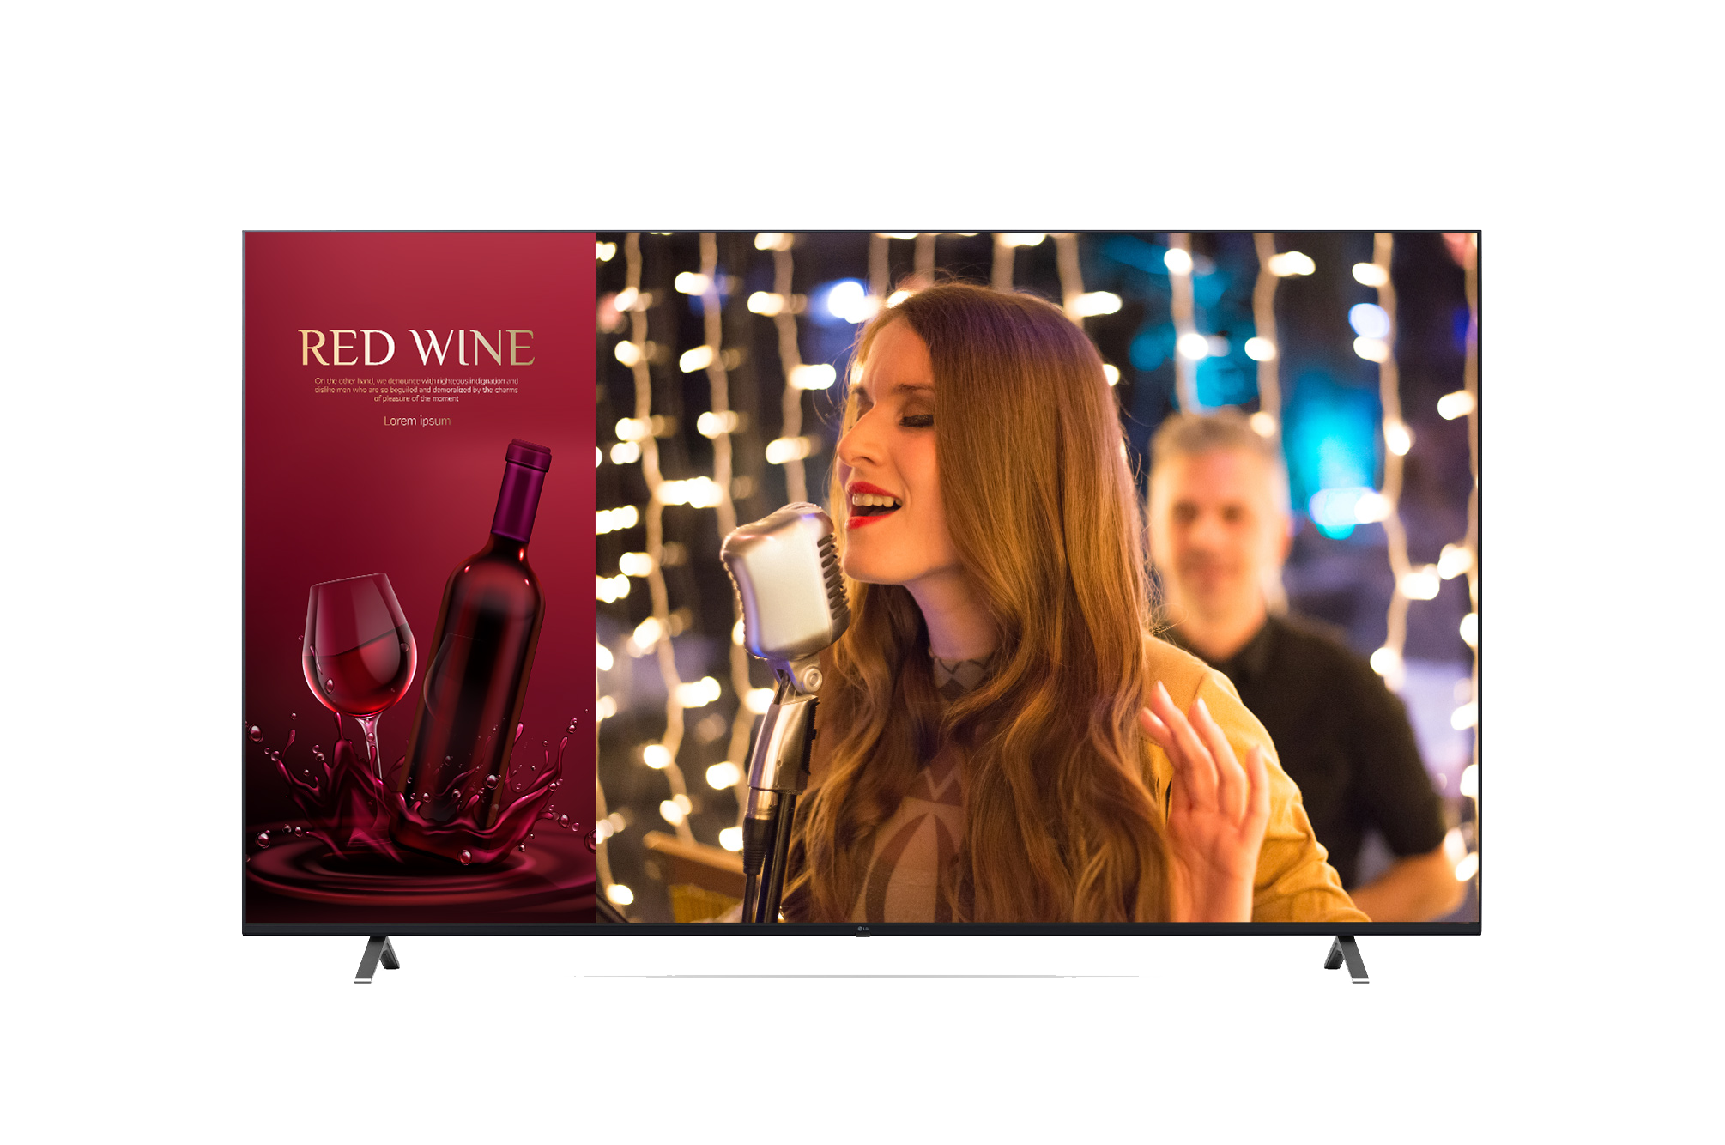
TV LG 75” Digital Signage
LG 75'' Digital Signage
• 3,840 x 2,160 (UHD)
• Screen Size 75”
• Smart Energy Saving 301 W
• HDMI x 2 , USB x 2
Datasheet : https://www.lg-informationdisplay.com/product/digital-signage/standard/86UR640S-ASIA

Slide 12
Project Organization Chart
INFINIX
Sale: K.Natsinee
Implement Team
Lead: K.Kunanake
K.Kunanake
K.Permjirat
K.Punyapon
K.Titiwut

